Slide 1
Chapter 5: Structural Modeling

Slide 2
Objectives
Understand the rules and style guidelines for creating class diagrams, and object diagrams.
Understand the processes used to create class diagrams, and object diagrams.
Be able to create class diagrams, and object diagrams.
Understand the relationship among structural models.
Understand the relationship between structural and functional models.

Slide 3

Introduction
Structural models represent system objects and their relationships:
People
Places
Things

Slide 4

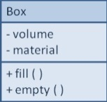
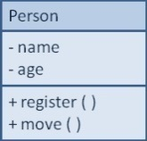
Structural Models
Main goal: to discover the key data contained in the problem domain and to build a structural model of the objects
Structural
Modeling
Solution Domain
Problem Domain

Slide 5
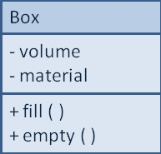
Classes, Attributes, & Operations
Classes
Templates for instances of people, places, or things
Attributes
Properties that describe the state of an instance of a class (an object)
Operations
Actions or functions that a class can perform

Slide 6
Relationships
Describe how classes relate to one another.
Three basic types in UML
Generalization
Enables inheritance of attributes and operations
Represents relationships that are “a-kind-of”
Aggregation
Relates parts to wholes or assemblies
Represents relationships that are “a-part-of” or “has-parts”
Association
Miscellaneous relationships between classes
Usually a weaker form of aggregation

Slide 7
Class Diagrams
A static model that shows classes and their relationships to one another
Elements
Classes
Objects within the system (a person, place or thing)
Stores and manages information in the system and contains:
Attributes—characteristics of the class
Operations—activities the class can perform
Relationships—the associations between classes
Depicted as lines between classes
Multiplicity indicates how many of one object is/are associated with other objects

Slide 8
Attributes
Properties of a class
Person: last name, first name, address, etc.
Attributes can be derived
Preceded with a slash (/)
e.g., age is derived from date of birth
Visibility of an attribute:
Restricts access to attributes to ensure consistency
Public attributes (+): visible to all classes
Private attributes (-): visible only to an instance of the class in which they are defined
Protected attributes (#): visible only to an instance of the class in which they are defined and its descendants

Slide 9
Operations
Common operations are not shown
Create or delete an instance
Return or set a value
Types of operations:
Constructor—creates an object
Query—makes information about the state of an object available
Update—changes values of some or all of an object’s attributes
Destructor—deletes or removes an object

Slide 10
Relationships
Denotes associations between classes
Depicted with a line labeled with the name of the relationship
May be directional (depicted with a triangle; e.g., a patient schedules an appointment)
Classes may be related to themselves (e.g., employees and managers who may be members of the same class)
Multiplicity indicates how many of one class are related to another class

Slide 11
Multiplicities
Department
Boss
Exactly one:
A department has one and only one boss
1
1
Employee
Child
Zero or more:
An employee has zero to many children
1
0..*
Boss
Employee
One or more:
A boss is responsible for one or more employees
1
1..*

Slide 12
Association Classes
Common in many-to-many relationships
Used when attributes about the relationship between two classes needs to be recorded
Students are related to courses; a Grade class provides an attribute to describe this relationship
Illnesses are related to symptoms; a Treatment class provides an attribute to describe this relationship

Slide 13
Generalization & Aggregation Associations
Generalization denotes inheritance
Properties and operations of the superclass are valid for the sub-class
Depicted as a solid line with a hollow arrow pointing at the superclass
Aggregation denotes a logical “a-part-of” relationship
Composition denotes a physical “a-part-of” relationship

Slide 14
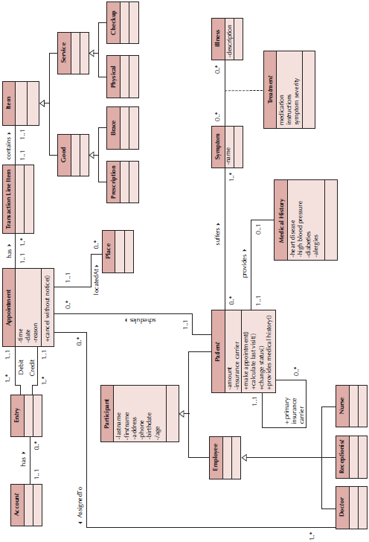
Sample Class Diagram

Slide 15
Simplifying Class Diagrams
Fully populated class diagrams of real-world system can be difficult to understand
Common ways of simplifying class diagrams:
Show only concrete classes
The view mechanism shows a subset of classes
Packages show aggregations of classes (or any elements in UML)

Slide 16
Object Diagrams
Class diagrams with instantiated classes
Example: instead of a Doctor class, create an actual doctor, say Dr. Smith
Place values into each attribute
Used to discover additional attributes, relationships and/or operations or those that are misplaced

Slide 17
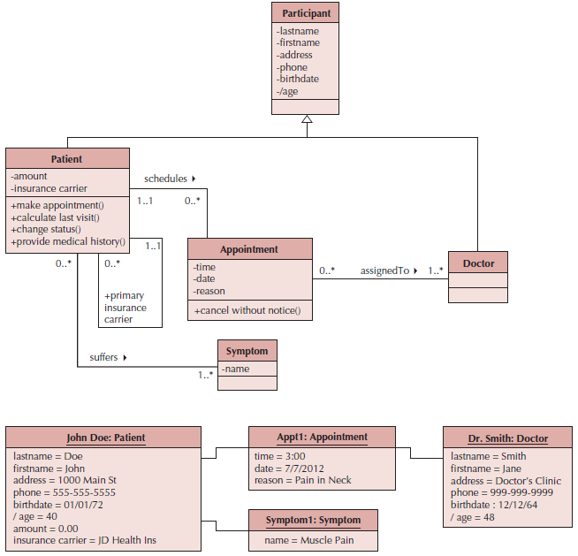
Example Object Diagram

Slide 18
Summary
Structural Models
Class Diagrams
Object Diagrams

